Slide 1
SDLC using Agile Methodology

Slide 2
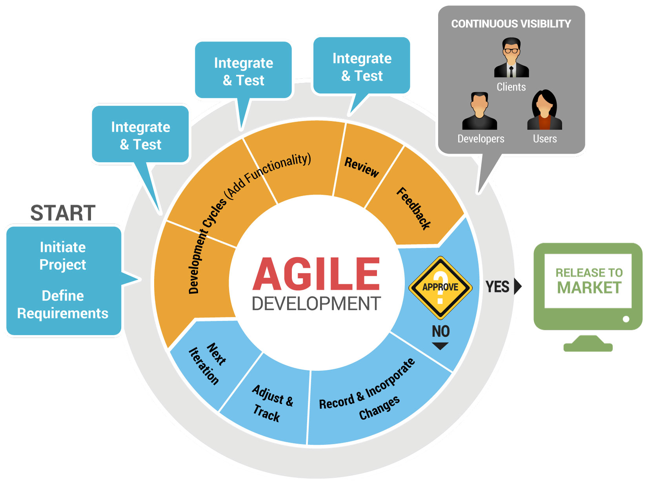
Agile Methodology
People collaborating together to build high quality products that meet customer needs at a sustainable pace
The tasks are divided to time boxes (small time frames) to deliver specific features for a release
Each delivery is incremental in terms of features; the final delivery holds all the features required by the customer
Iterative approach is taken and working software is delivered after each iteration

Slide 3
Agile Manifesto/Philosophy
Individuals and Interactions
Self-organization, motivation and interactions are important
Working Software
Working software is more useful and welcome than just presenting documents to clients in meetings
Customer Collaboration
Requirements cannot be fully collected at the beginning of the software development cycle, therefore continuous customer or stakeholder involvement is very important
Responding to Change
Agile methods are focused on quick responses to change and continuous development
Over
Process and Tools
Over
Comprehensive Documentation
Over
Contract Negotiation
Over
Following a Plan

Slide 4
Agile Process Principles
Highest priority is to satisfy the customer through early and continuous delivery of valuable software.
Welcome changing requirements, even late in development.
Deliver working software frequently, from a couple of weeks to a couple of months, with a preference to the shorter timescale.
Business people and developers must work together daily throughout the project.
Build projects around motivated individuals. Give them the environment and support they need, and trust them to get the job done.
The most efficient and effective method of conveying information to and within a development team is face-to-face conversation.

Slide 5
Agile Process Principles
Working software is the primary measure of progress
Agile processes promote sustainable. The sponsors, developers, and users should be able to maintain a constant pace indefinitely
Continuous attention to technical excellence and good design enhances agility
Simplicity - the art of maximizing the amount of work not done--is essential
The best architectures, requirements, and designs emerge from self-organizing teams
At regular intervals, the team reflects on how to become more effective, then tunes and adjusts its behavior accordingly (Frequent Review).

Slide 6
Agile using SCRUM

Slide 7
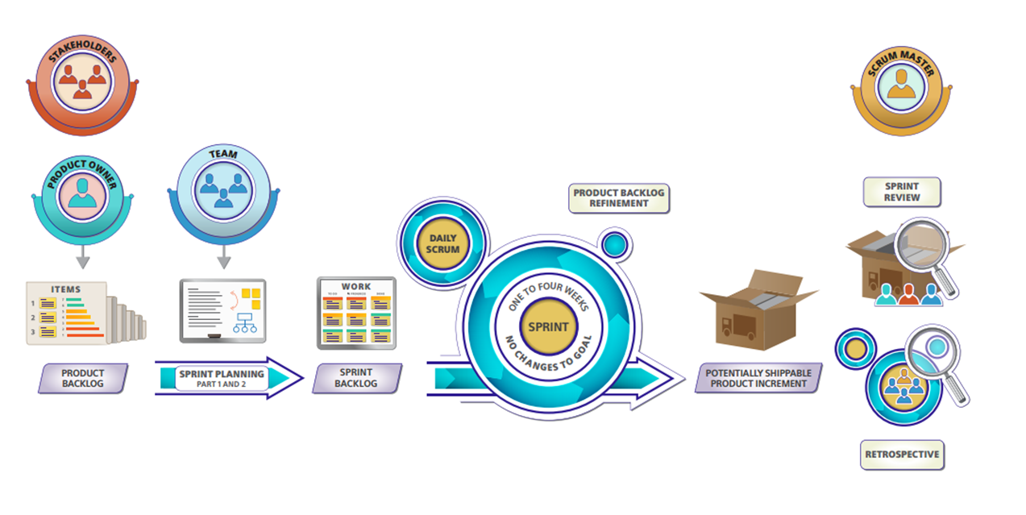
What is SCRUM?
Scrum is an agile lightweight process framework for development
Can manage and control software/ development
Uses iterative, incremental practices
Has a simple implementation

Slide 8



SCRUM Values
Focus
Focus only on few things at a time
Respect
Respect and trust each other within the team
Openness
Every thing about the project is transparent to every one
Greater control over what we do and how we do
Work well together and produce excellent work
Commitment
Courage
As we work together and feel supported we are courageous to be open and challenge ourselves to go beyond our capabilities
Sharing success and failure
Create a culture of openness
We become more committed for success

Slide 9
SCRUM Framework
The Scrum framework consists of Scrum Teams and their associated roles, events, artifacts, and rules. Each component within the framework serves a specific purpose and is essential to Scrum’s success and usage
Roles
Product Owner
Ceremonies
Sprint Planning
Artifacts
Product Backlog
Agreements
Scrum Master
Scrum Team
Sprint Review
Sprint Retrospective
Daily Scrum Meeting
Sprint Backlog
Burndown Charts
Definition of Ready
Definition of Done

Slide 10
SCRUM Roles

Slide 11
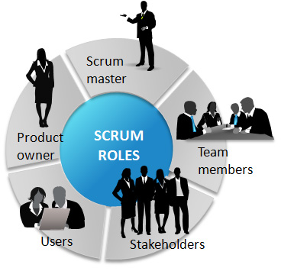
SCRUM Roles
Product Owner
Represents the Business side of the Product / Software Development
Scrum Master
Represents the People side of the Product/Software Development
Development Team
Represents the Technology side of the Product/Software Development

Slide 12

Product Owner
Creating Product Vision
Scope Management
Stakeholder Management
Represents the business side of the Product/Software Development
The Product Owner is responsible for maximizing the value of the product and the work of the Development Team
The Product Owner is the sole person responsible for managing the Product Backlog
Release Management

Slide 13

Scrum Master
Vision: Understand the product vision and lead/coach the team to work towards it
Product Backlog Refinement: Help PO in defining and maintaining the product backlog
Sprint Planning: Facilitate the Sprint Planning meeting & help team to create the Sprint Backlog
Development: Coach team to self-organize and help them to resolve the Impediments
DSM: Facilitate and help the team to inspect the progress towards the sprint goal
Sprint Review: Facilitate and ensure that the focus is on integrated product increments
Sprint Retrospective: Facilitate and help team to inspect and adapt the process

Slide 14

Development Team
The Development Team is responsible for delivering a potentially shippable increment of working software
Develop high quality solution to fulfil the product/software vision
The Development Team is Self-organized
The Development Team is Cross functional
The Development Team is Empowered & autonomous
Collectively responsible for delivery
Size will be between 6 to 7 (recommended)

Slide 15
SCRUM Sprint

Slide 16
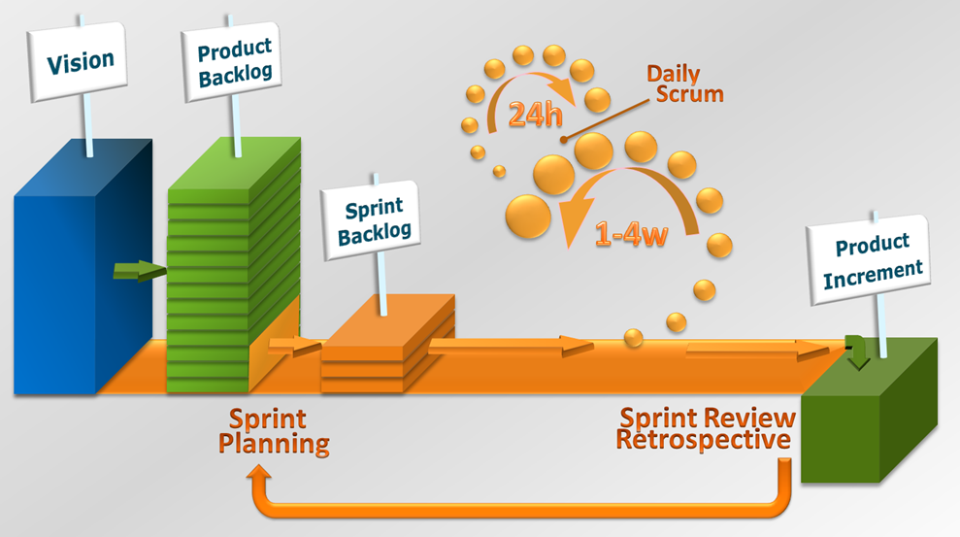
The Sprint
The heart of Scrum is a Sprint
A sprint is a set period of time during which specific work has to be completed and made ready for review
Time-box of one month or less
Sprints consists of the Sprint Planning, Daily Scrums, the development work, the Sprint Review, and the Sprint Retrospective
During which a “Done”, useable, and potentially shippable product Increment is created
A new Sprint starts immediately after the conclusion of the previous Sprint
No changes are made that would compromise the Sprint Goal
Scope may be clarified and re-negotiated between the Product Owner and Development Team as more is learned.

Slide 17

Timeboxing
Its fixed span of time called as Sprint in Scrum which has:
Fixed Goal, Fixed Team, Fixed Length, Product Increment at the end
Why Timeboxing?
- Helps stay focused on the Goal
- If we don't decide the time box of any ceremony or events, then some people will keep on discussing and others will lose interest
- Moreover, the team will get less time to work on sprint tasks. So having the timeboxes is very important to keep people motivated
Maximum length of the Sprint
-Recommended by Scrum framework is 4 weeks

Slide 18
Activities/Events/Ceremonies in SCRUM
Product Backlog Refinement
Sprint Planning
Daily Scrum Meeting
Sprint Review
Sprint Retrospective

Slide 19
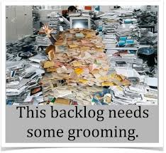
Product Backlog Refinement-
Timebox [Up to 10% of Sprint Capacity]
Purpose
Understand the Product Backlog and keep it ready for at least couple of Sprints
Participants Scrum Team, optionally the other SMEs
Input
Product Backlog
Output
Sprint Backlog

Slide 20
Sprint Planning- Timebox [Max 2-8 hours]
Purpose
For Scrum Team to craft a Sprint Goal and create a plan to achieve it
Participants
Scrum Team
Inputs
Product Backlog, Capacity, Product Increment
Outputs
Sprint Goal, Sprint Backlog, Sprint Burndown
Activities:
Craft a Goal: Answer why are you running this sprint
Create a Plan: Identify PBIs (Product Backlog Items) required to achieve the Sprint Goal and commit based on Teams Velocity.

Slide 21
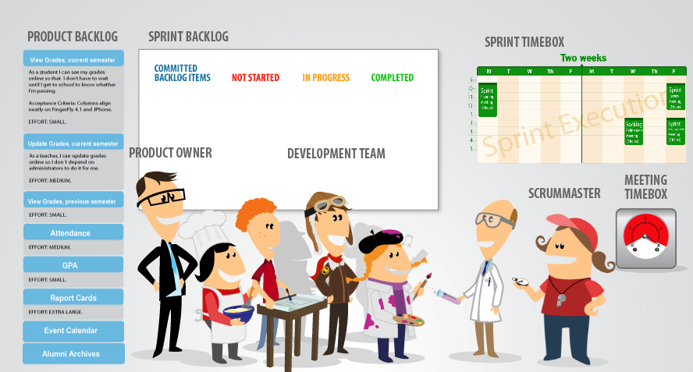
Sprint Planning- Timebox [Max 2-8 hours]

Slide 22
Daily Scrum- Timebox [Max 15 minutes]
Purpose
A formal opportunity to inspect the teams progress with respect to Sprint Goal
Participants
Development Team, Scrum Master, Product Owner (optional)
Inputs
Sprint Backlog, Sprint Burndown
Output
Action item to resolve impediments
Activities:
Inspect: Where do we stand with respect to the Sprint Goal?
Identify: Are there any impediments to making progress?
Adapt: What should we do to achieve Sprint Goal?
3 Important Questions
What work did you complete yesterday?
What have you planned for today?
Are you facing any problems or issues?

Slide 23
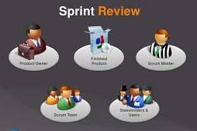
Sprint Review- Timebox [Max 1-4 hours]
Purpose
For stakeholders to review the work done by the Scrum team and provide feedback
Participants
Scrum Team, Sponsors, Customers, End Users etc
Inputs
Product Increment, Sprint Goal, Release Burndown
Output
Updated Product Backlog
Activities:
Report: Product Owner explains the Sprint Goal and what is done and not done
Demo: Development Team demos the Product Increment and Stakeholders provide feedback
Forecast: Product Owner discusses the Product Backlog as it stands today and projected completion date

Slide 24

Sprint Retrospective - Timebox [Max 1-4 hours]
Purpose
Formal opportunity to review how the last Sprint went and identify areas for continuous improvement for future Sprints
Participants
Scrum Team
Inputs
Sprint Burndown, Impediment List, Comments from Sprint Review
Output
Action items for next sprint
Activities:
Reflect Back: Scrum Team discusses how the Sprint went and identify root causes and action items for improvement
Look Forward: Identify improvement ideas for continuous improvement

Slide 25
Artifacts of SCRUM
Product Backlog
Sprint Backlog
Product Increment

Slide 26
Product Backlog
Anything and everything required to fulfill the product vision contains
Functional Requirements
Non-functional Requirements
Change Requests
Enhancements
Defects
POC (Proof of Concept)
Should be detailed enough

Slide 27
Sprint Backlog
It’s a plan which helps Development Team to self-organize to achieve the Sprint Goal
The PBI’s that team plans to deliver to achieve Sprint Goal
Tasks required to accomplish planned PBI’s

Slide 28
Product Increment
It’s an integrated increment of final product released iteratively
Release Notes
User Manual
Support Documents etc.
Software Package

Slide 29
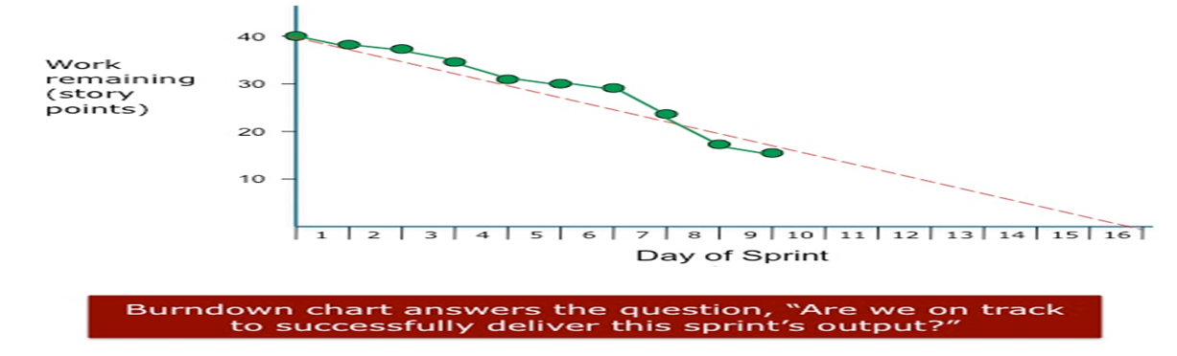
Burndown Chart
Development team uses the Sprint burndown for inspecting the progress with respect to the Sprint Goal and determining the plan to achieve the Sprint Goal
Development Team creates during the Sprint Planning
Development Team updates the burndown as and when the work is done

Slide 30
Agreements In SCRUM
Definition Of Ready
Definition of Done
Its any entry criteria agreed by Product Owner and Development Team to start the development of Product Backlog Item
Its an exit criteria agreed by Product Owner and Development Team to consider a PBI is done and ready to be shipped
Examples:
No open questions about PBI
Acceptance criteria written
No technical dependencies
PBI estimated and split small enough to fit in to a Sprint
Examples:
Coded
Reviewed
Bug Fixed
Packaged
Test Cases Written
Tested
Integrated
Deployed
Accepted by Product Owner

Slide 31
User Stories
User Stories are Product Backlog Items that are descriptions of functionality
The User Story always takes the form:
Who (user role) – Is this a customer, employee, admin etc.?
What (goal) – What functionality must be achieved/developed?
Why (reason) – Why does user want to accomplish this goal?
Example:
“As a frequent traveler I want to be able to quickly rebook frequently booked flights so that I can save time during the booking process”
“As a frequent traveler I want to be able to quickly rebook frequently booked flights so that I can save time during the booking process”

Slide 32
User Stories
A Story is an:
Independent
Negotiable
Valuable
Estimable
Sized properly
Testable

Slide 33

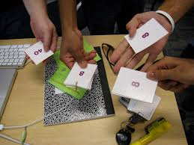
Planning Poker
Its an iterative approach to estimating
Steps:
Each estimator is given a deck of cards, each card has a valid estimate written on it
Customer/Product owner reads a story and it’s discussed briefly
Each estimator selects a card that’s his or her estimate
Cards are turned at the same time
Discuss differences (especially outliers)
Re-estimate until estimates converge

Slide 34
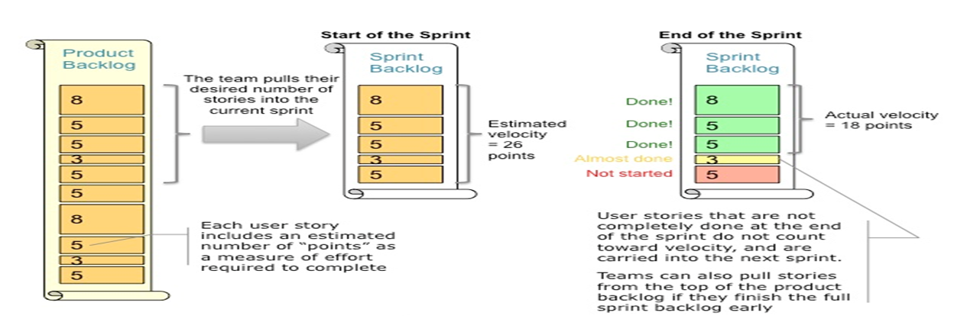
Velocity
It’s a measure of how much work a Scrum Team can do in a Sprint
It’s calculated at the end of the Sprint by summing up story points associated with the Product Backlog items done
Used to calculate approximate cost of release and track release progress

Slide 35

Let’s Play (ACTIVITY)
Design an

Slide 36
Hit the Given Target As many number of times as you can within the stipulated time from a specific Distance by travelling smoothly.

Slide 37
Agile Benefits
Customer: High-value features are developed and delivered more quickly with short cycles, than with the longer cycles favored by classic “waterfall” processes
Development Teams: Team members enjoy development work, and like to see their work used and valued. Scrum benefits Team members by reducing non-productive work (e.g. writing specifications or other artifacts that no one uses), and giving them more time to do the work they enjoy
Product Managers: Product Managers, who typically fill the Product Owner role, are responsible for making customers happy by ensuring that development work is aligned with customer needs. Scrum makes this alignment easier by providing frequent opportunities to re-prioritize work, to ensure maximum delivery of value
Project Managers: Project Managers who fill the Scrum Master role find that planning and tracking are easier and more concrete, compared to waterfall processes. The focus on task-level tracking, the use of Burndown Charts to display daily progress, and the Daily Scrum meetings, all together give the PM’s awareness about the state of the project at all times
Top Management: Scrum provides high visibility into the state of a development project, on a daily basis. External stakeholders, such as top executives and personnel in the Project Management Office, can use this visibility to plan more affectively, and adjust their strategies based on more hard information and less speculation

Slide 38
Pros & Cons of SCRUM
Pros
Cons
Is a very realistic approach to software development
Not suitable for handling complex dependencies
Promotes teamwork and cross training
Functionality can be developed rapidly & demonstrated
Resource requirements are minimum
Suitable for fixed or changing requirements
Delivers early partial working solutions
Good model for environments that change steadily
Minimal rules, documentation easily employed
Enables concurrent development and delivery within an overall planned context
Little or no planning required
Easy to manage
Gives flexibility to developers
More risk of sustainability, maintainability and extensibility
An overall plan, an agile leader and agile PM practice is a must without which it will not work
Depends heavily on customer interaction, so if customer is not clear, team can be driven in the wrong direction
There is very high individual dependency, since there is minimum documentation generated
Transfer of technology to new team members may be quite challenging due to lack of documentation

Slide 39
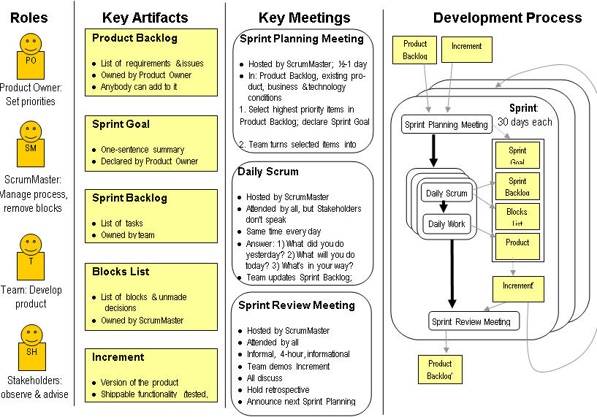
Scrum Summary

Slide 40
Waterfall v/s Agile

Slide 41
Agile v/s Waterfall
Waterfall Approach
Design
Spec
Code
UAT
Launch
Change Management & Approval
Agile Approach
Users
Stories
Sprint
Sprint
Sprint

Slide 42
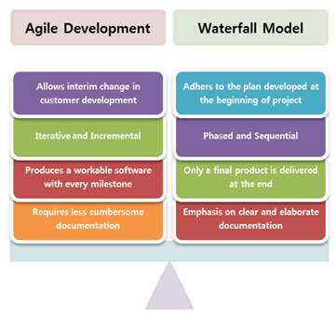
Agile v/s Waterfall

Slide 43
Questions ?

Slide 44
Thank You

